Slide 1

Welcome to
Medicare 101
2023 Edition

Slide 2

Top Medicare Questions
Who is eligible for Medicare?
When can I enroll?
What are my coverage options?
What are my next steps?
Once I am covered by Medicare, how could I save money?
Where can I find more information?

Slide 3

Q1: Who is eligible for Medicare?
People age 65 or older
Younger people with disabilities
People with End Stage
Renal Disease

Slide 4
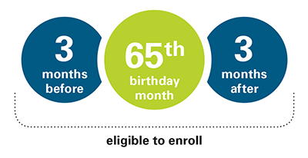
Q2: When Can I Enroll?
Initial Enrollment Period
Remember, in most cases, if you don’t sign up for Part A (if you have to buy it) and Part B when you’re first eligible, you may have to pay a late enrollment penalty.
Enrollment in Part A is automatic if you are already receiving Social Security Benefits
Some people get Part A and Part B automatically
Some people have to sign up for Part A and/or Part B

Slide 5
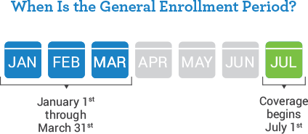
If You Missed Your Initial Enrollment Period
General Enrollment Period
If you didn’t sign up for Part A (if you have to buy it) and/or Part B (for which you must pay premiums) during your Initial Enrollment Period, and you don’t qualify for a Special Enrollment Period, you can sign up between January 1–March 31 each year. Your coverage won’t start until July 1 of that year, and you may have to pay a higher Part A and/or Part B premium for late enrollment.
For Part A, usually no penalties (unless you didn’t pay enough into Social Security)
For Part B, premiums will be higher after the Initial Enrollment Period
(unless you qualify for an exception)
For Part C and D, have to wait until the Annual Enrollment Period (AEP), October 15- December 7th
For Part D, premiums will be higher after the Initial Enrollment Period
(unless you qualify for an exception)
For Med Supp, you can apply later but may be charged a higher premium due to existing health problems, or rejected depending on your health history.

Slide 6

If You Work Past 65
Working past age 65
You May enroll in Medicare Parts A and B
Recommend talking to your benefit advisor
Keep records of your health insurance coverage
Retiring after 65
When retiring, you’re eligible for Special Enrollment Period
Allow for 63 days after employer-sponsored coverage ends to enroll in a Medicare plan without penalty
Best to sign up before you retire to avoid lapse in coverage.

Slide 7
Q3: What are my coverage options?
Part A
Part B
Part C
Part D
Med Supp
Part A & B are “Original Medicare”
Part A (Hospital Insurance) | Part B (Doctor & Outpatient Visits)
Inpatient Hospital Care | Outpatient Care
Skilled Nursing Services | Physician Services
Inpatient Mental Health Care | Ambulance
Hospice Care | Laboratory Services
Some Blood Transfusions | Durable Medical Equipment
Some Home Health Care | Some Preventive Care

Slide 8
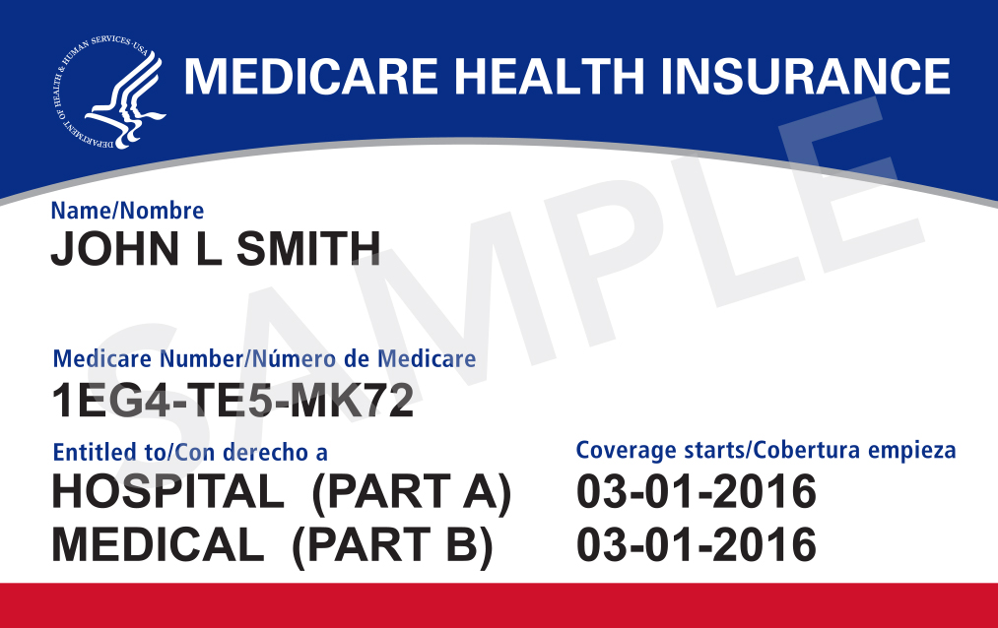
Original Medicare Continued
What does Part A cover?
Part A (Hospital Insurance) helps cover:
  Inpatient care in a hospital
  Inpatient care in a skilled nursing facility (not custodial or long-term care)
  Hospice care
  Home health care
  Inpatient care in a religious nonmedical health care institution
  Important Part A Notes
  Cannot be denied coverage due to medical history or pre-existing conditions
  No monthly premium for most people
  Responsible only for the deductible for a hospital stay less than 60 days
  Hospital stays longer than 60 days require a daily copay
  Multiple stays = Multiple deductibles
  You can be treated anywhere that accepts new Medicare patients
  International hospital care not typically covered

Slide 9
Original Medicare Continued
What does Part B cover?
Part B (Medical Insurance) helps cover:
  Medically necessary doctors’ services
  Outpatient care
  Home health services
  Durable medical equipment
  Mental health services, and other medical services
  Many preventive services
  Important Part B Notes
  Cannot be denied coverage due to medical history or pre-existing conditions
  20% co-insurance of Medicare-approved costs
  No maximum out-of-pocket
  Monthly premium determined by income
  Premiums may rise if you join after initial enrollment period

Slide 10
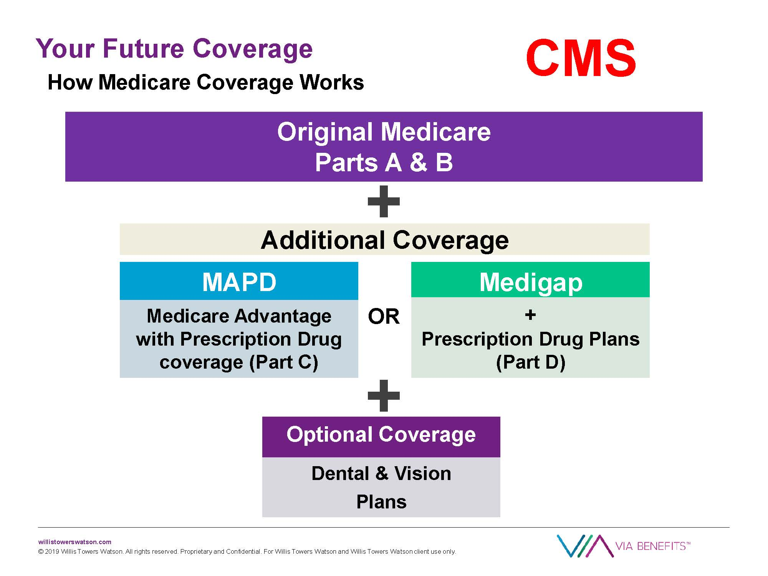

Slide 11
Part C is “Medicare Advantage”
  Eligibility, Cost, and Coverage
  Must be enrolled in Medicare Parts A and B
  Plans offered by service area and frequently limited to service area
  Cannot be ineligible because of health
  or financial status
  Cannot have end-stage renal disease (ESRD)
    Special rules apply for those with ESRD
    Some may be able to join an SNP plan if one
    is in their service area
  Plans and premiums change annually
  Your Part B premium must continue to be paid
  Must see doctors and receive treatment in
  hospitals that are considered in-network
Part C / Medicare Advantage
Combined Parts A & B
Many plans include Medicare Part D (Prescription Drug Coverage)
Offered by Private Companies
Can also include Vision, Hearing and Wellness Services
HMO, PPO, SNP, HMO-POS, PFFS, and MSA plans available

Slide 12
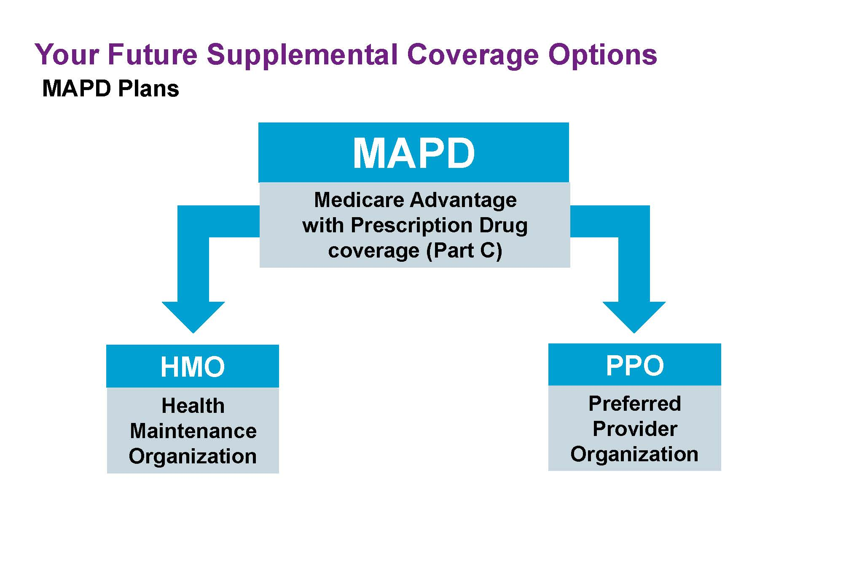

Slide 13
Part D is “Prescription Drug Coverage”
  Enrollment, Cost, and Coverage
Must enroll; coverage not automatic
Penalties will apply for late enrollment
Prescription Drug coverage costs vary from plan to plan
Benefits change each year
Cost of prescription drugs (including many recommended shots or vaccines)
Catastrophic coverage offers protection from high drug costs
Each plan has a list of covered prescription drugs
The list changes each year
Be sure to verify your prescriptions are covered before you enroll in a plan
Most drug plans have the drugs they cover organized into tiers, which are groups of drugs divided by cost. The higher-tier is higher cost, down to low
Part D / Prescription Drug Coverage
Assists with the costs of Prescription drugs
Offered through private insurance companies
Part B premium must continue to be paid

Slide 14
Standardized Medicare Supplement Plans
  Eligibility, Enrollment, Cost, and Coverage
Must be enrolled in Medicare Parts A & B
Must be a resident of the state where you are applying for coverage
Must be age 65 or greater unless you have certain disabilities that qualify you for earlier coverage in your state
You pay the private insurance company a monthly premium for your Medigap policy in addition to your monthly Part B premium that you pay to Medicare.
Any age if you have End Stage Renal Disease (ESRD)
Covers some out-of-pocket costs not paid by Medicare
Guaranteed issue during Open Enrollment Period; Period begins 1st day of the month that you are enrolled in Medicare Part B and in most states lasts 6 months
Coverage spans across U.S.
Guaranteed to continue as long as your premiums are current, and you have not made any misrepresentations on your application
Medicare Supplement / Medigap
You can be denied coverage if you enroll late
Helps cover what Parts A & B do not cover (deductibles, coinsurance, and copayments)
Benefits differ by plan
Premiums increase with higher coverage
Plans offered are A, B, C, D, F, G, K, L, M, N, and High Deductible Plan F

Slide 15
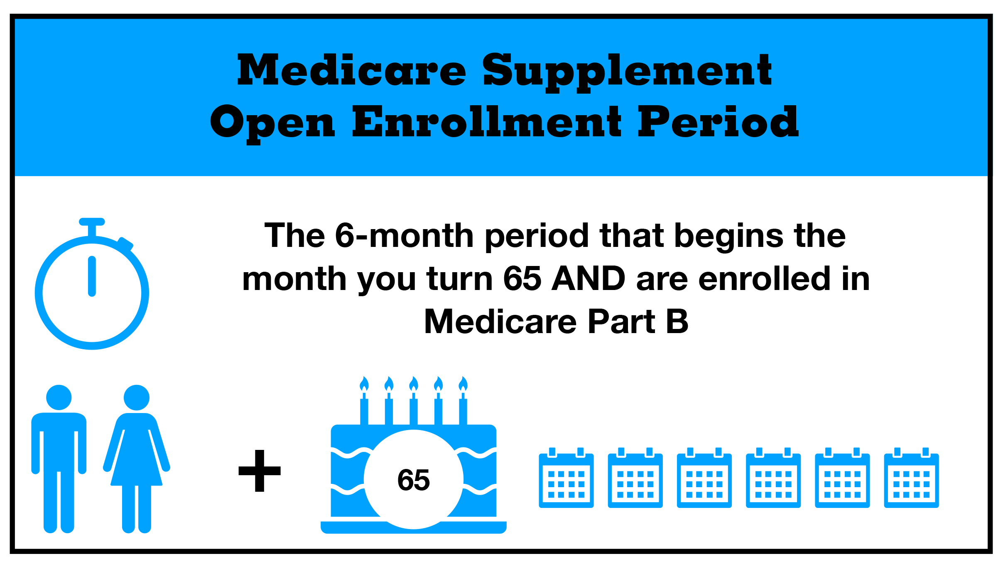

Slide 16
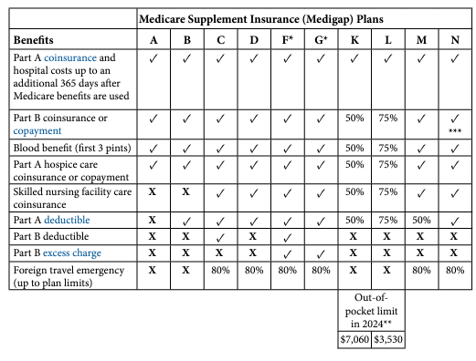

Slide 17
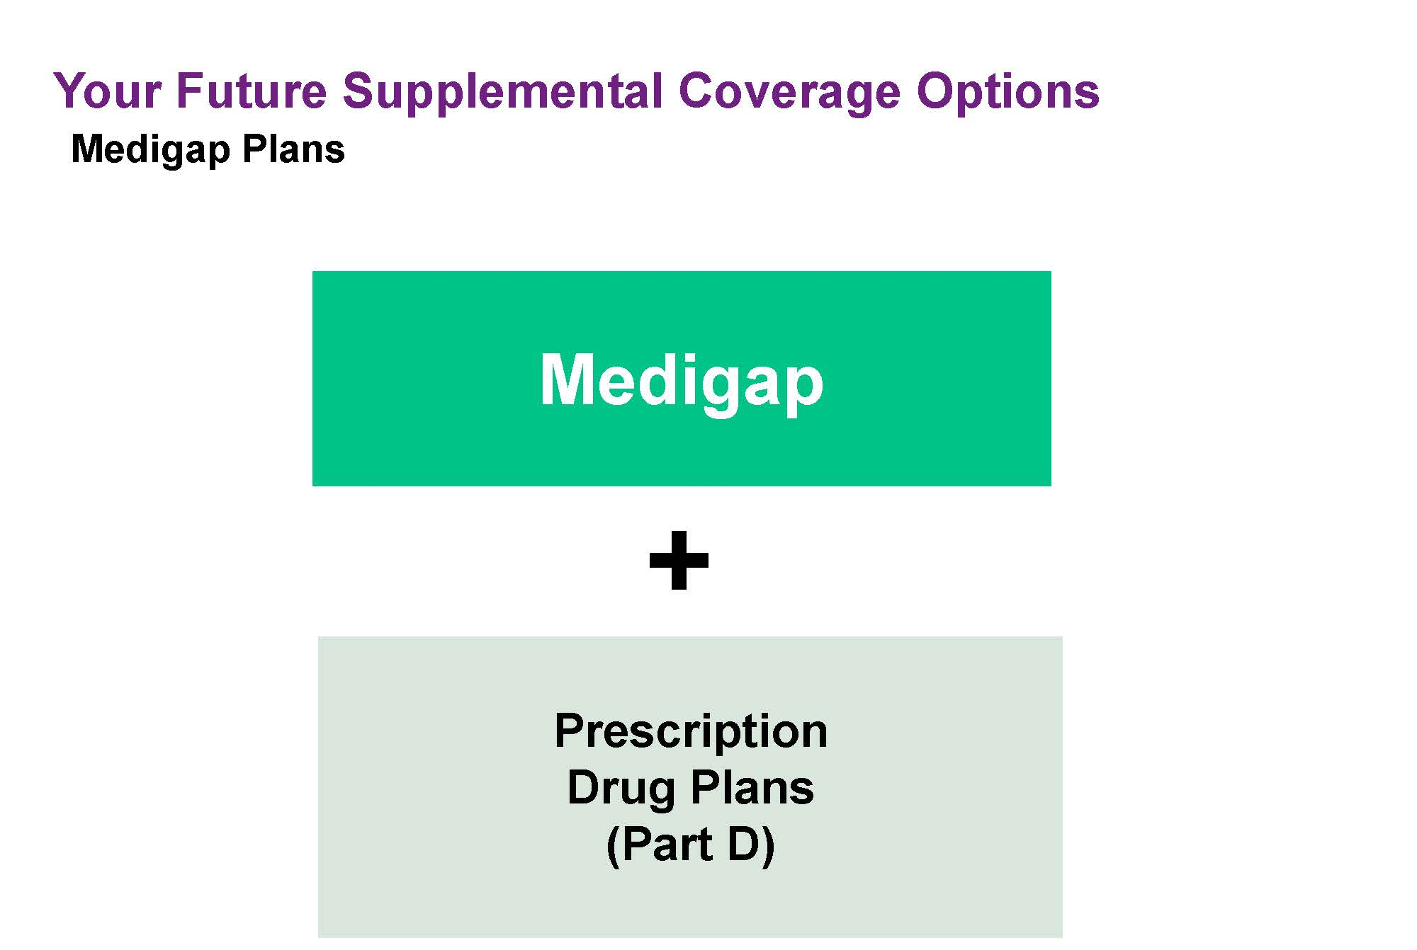

Slide 18
Step 1:
Enroll in Original Medicare when Eligible
Part A
Part B
Step 2:
Choose More Coverage if Needed
Option 1:
Medicare Supplement with/without Medicare Part D
Option 2:
Medicare Part C (Medicare Advantage) Combines Parts A,B, and many times D plus additional benefits

Slide 19
Q4: How can I save money once I’m covered by Medicare?
USE YOUR BENEFITS!
REVIEW ANNUALLY!
Make wellness appointment A.S.A.P.
Participate in preventive services
Stay in-network
Know your “extra benefits” beyond Original Medicare
Have my finances changed?
Has my health changed?
Have I moved?
Will I be out of my hometown for a long period within the next year?
How often and how far do I typically travel?
Are my doctors and hospital of choice in-network?
Are my prescriptions covered?
Does my coverage offer additional benefits like dental care, hearing aids, or a gym membership?

Slide 20
Q5: Where can I get more information?
Contact your
insurance agent
Call 1-800-MEDICARE
(1-800-633-4227)
TTY 1-877-486-2048
Open 24 hours/7 days
Visit www.medicare.gov
Call your SHIP (State Health
Insurance Assistance Program)
to see if you are eligible for
any financial assistance

Slide 21
Q6: What Are My Next Steps?
Review the enrollment periods
Review your options
Ask questions & get answers
Research financial assistance options
Enroll
Participate in the yearly review

Slide 22
Any Questions?
Thank you for Attending!

